Slide 1
Welcome To My Presentation
Software Development-1

Slide 2
A Project on Employee Record System Project Supervisor: Ahmed Shoeb Al Hasan

Slide 3
Introduction
My project on employee record system. It is a core software in every institution for handling the problem of storing the information, calculation the salary including bonus, address & other required information of the employees. The software is based on C language.

Slide 4
Information about our software
Just need some knowledge to operate this
Very fast and accurate
Password protected
Saves time
Can be updated according to the changing need of user

Slide 5
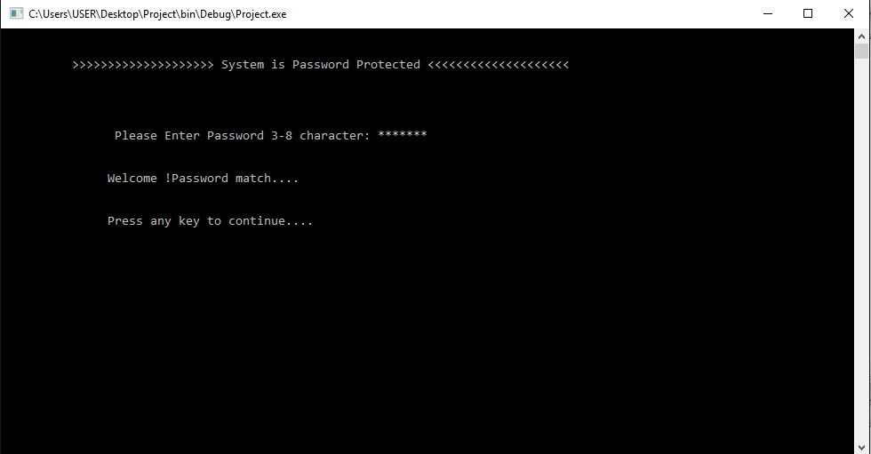
The system provides the users a strong security system as it is password protected. It will work only when it get the correct password. In other case it will not work. We provide the password in this software is “bubt293”.

Slide 6
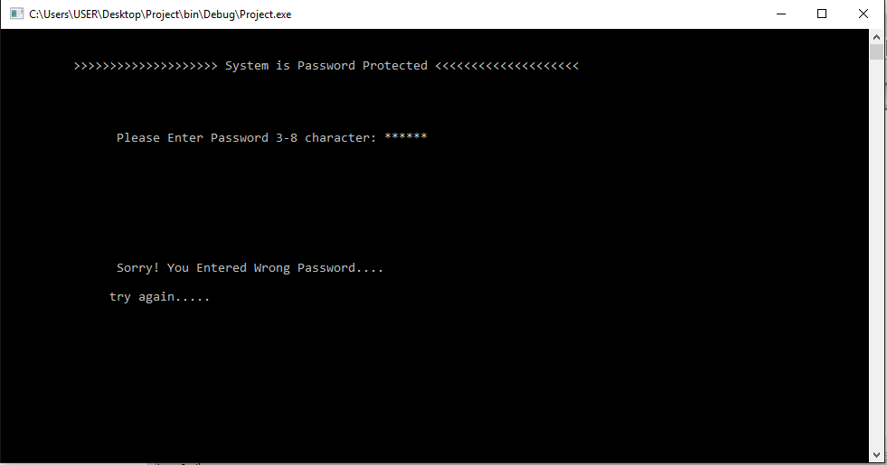
If the password is wrong it will not work.

Slide 7
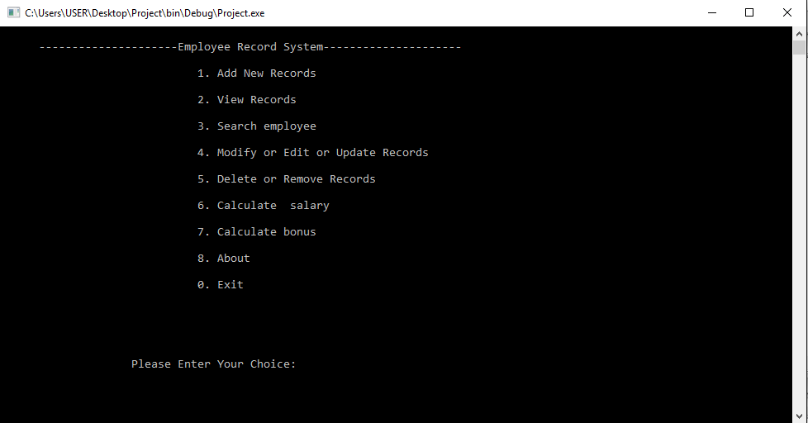
The program is simple enough to handle. All required feature is added in the main menu. A user can make his/her choice easily from the options.

Slide 8
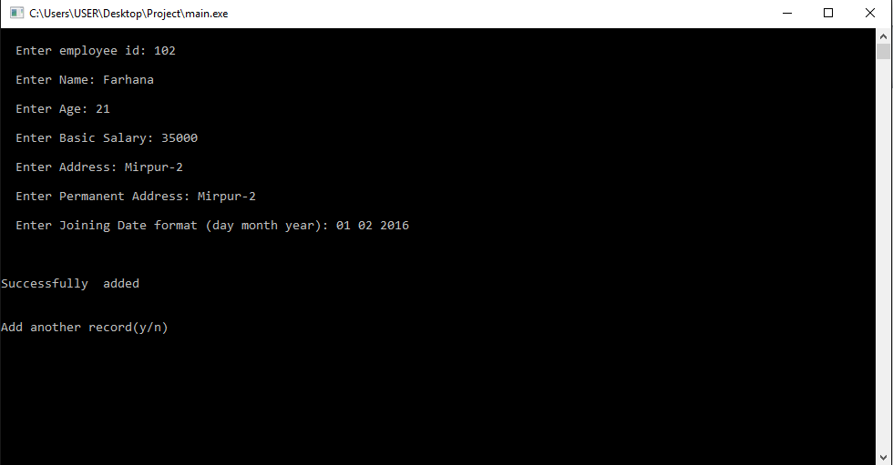
The program is accurate in the case of data input and other calculation. We can store and modify any data at any time efficiently. A closer look adding data is showing below

Slide 9
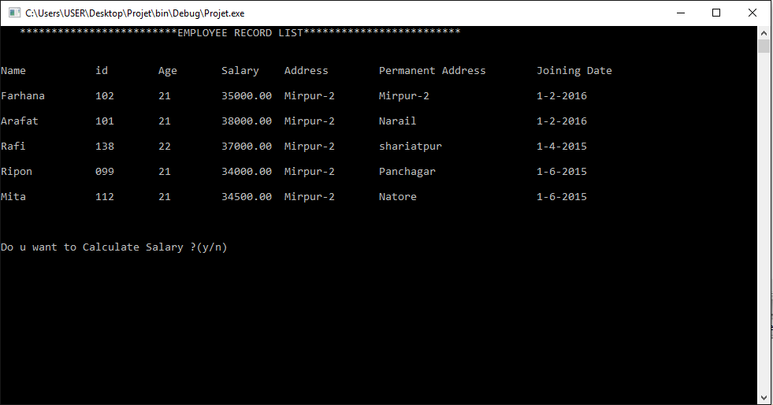
All employee records is showing below

Slide 10
Before modified

Slide 11
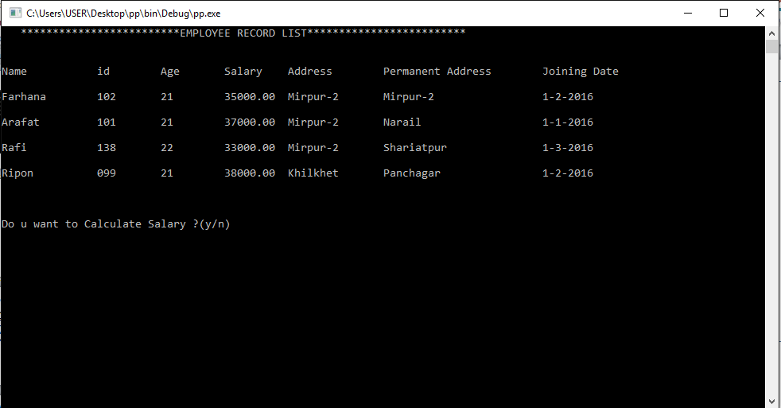
After modified

Slide 12
An Important Feature
We use id number to identify of an employee for avoiding the bug for same name of any two employees. For this a user must maintain the id number separately for each employee.

Slide 13
Thank you
That’s all of my software. I am determinant that I can make this software more useful and up to date according to changing need of user.

Slide 14
References
Programming With C By Byron Gottfried
Teach Yourself C By Herbert Schildt
Guider By Senior Students & Teachers
Google

